Slide 1
PHOTOGRAPHY
PORTFOLIO
Chad Gibbons

Slide 2

About Me
Hello, my name is Aaron Loeb. I am 23 years old and have a hobby of photography. I am a photographer with 3 years experience as a food and landscape photography portrait photographer. I started my career in photographer since I was 19 years old.

Slide 3
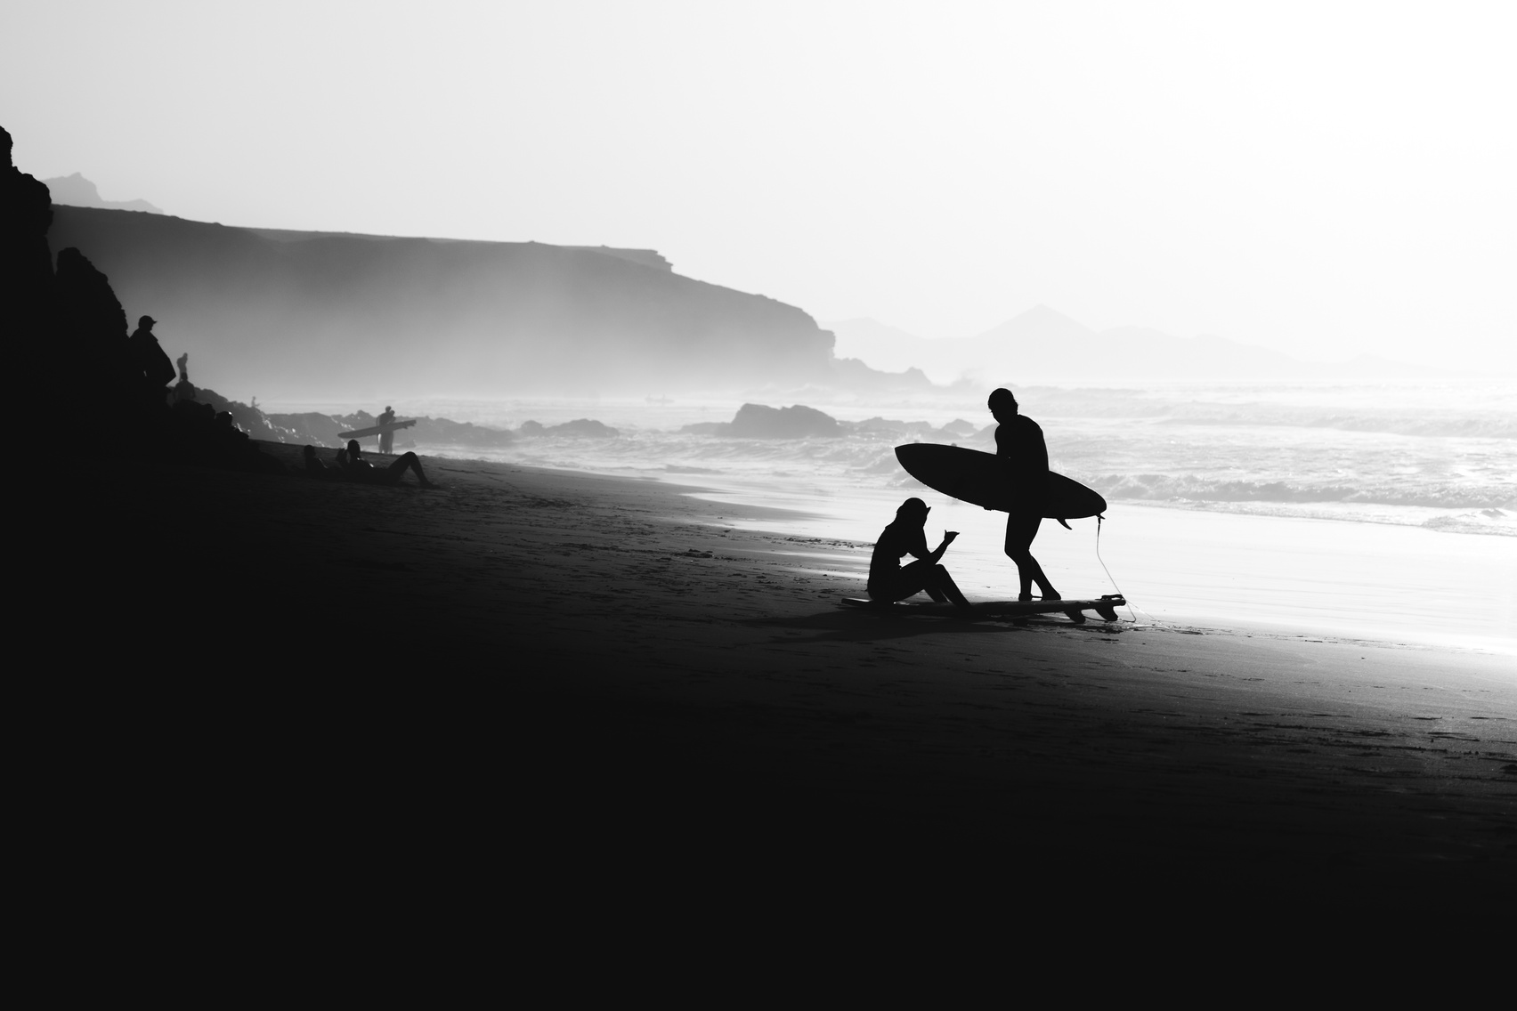
Building Photography
photography by combining the concept of a building with the technique of taking pictures from the bottom to the top.

Slide 4
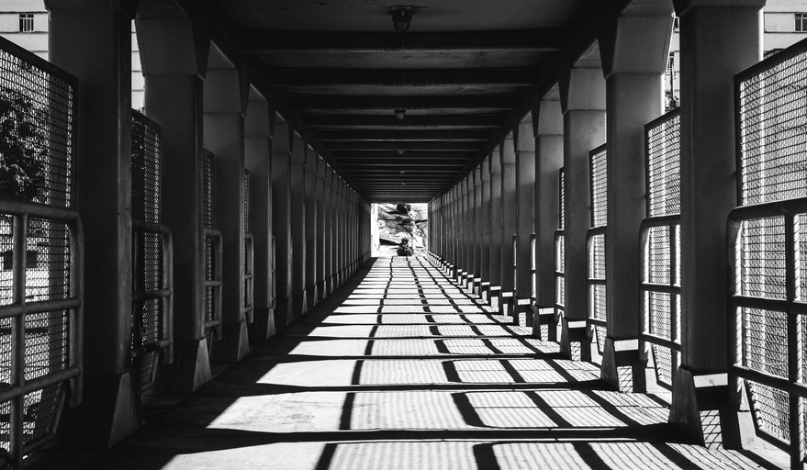
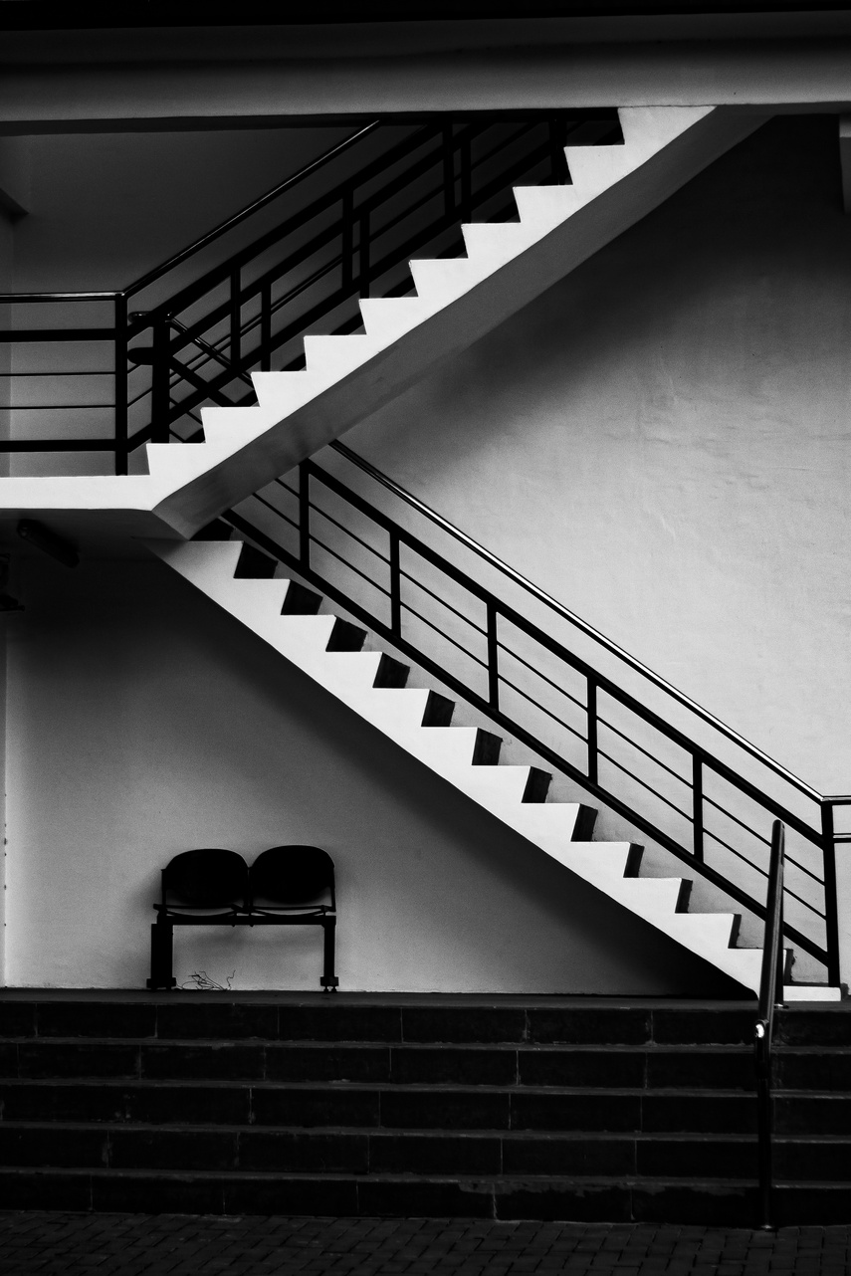
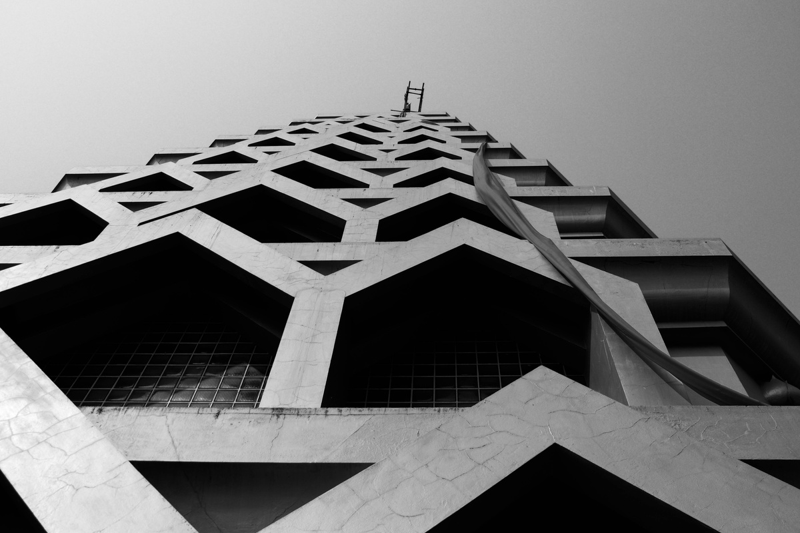
Building Photography
photography by combining the concept of a building with the technique of taking pictures from the bottom to the top.

Slide 5
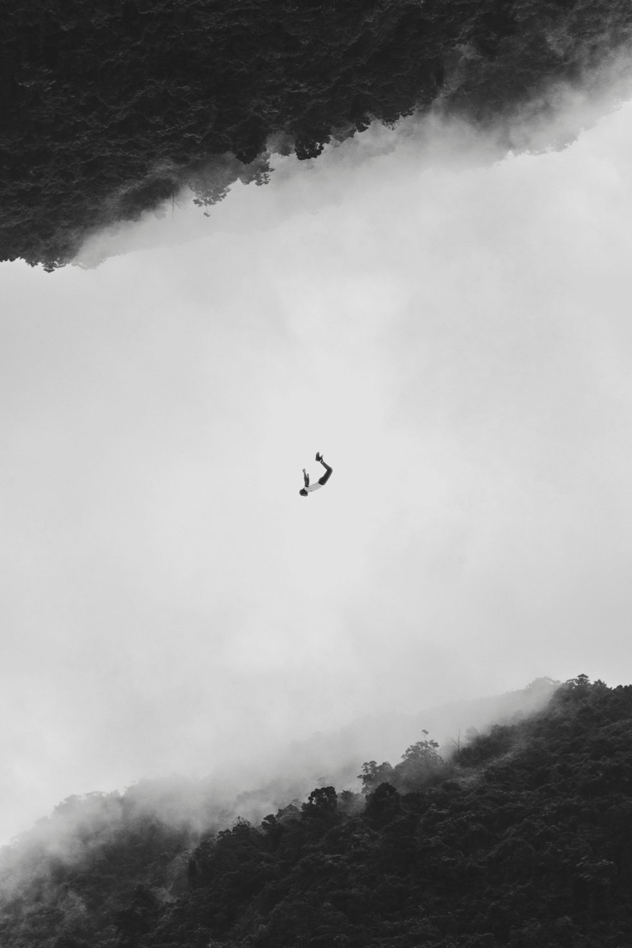

Work Experience
Rimberio Co. Studio
Product Potographer (2019 - 2020)
Studio Shodwe New York
Pottait Photographer (2020 - 2021)

Slide 6
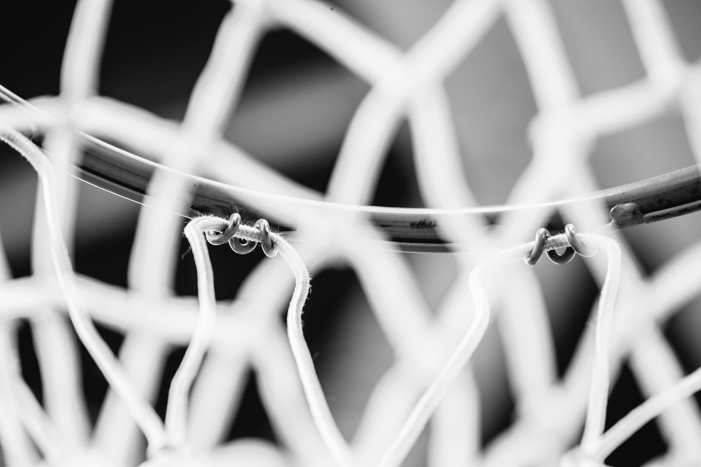

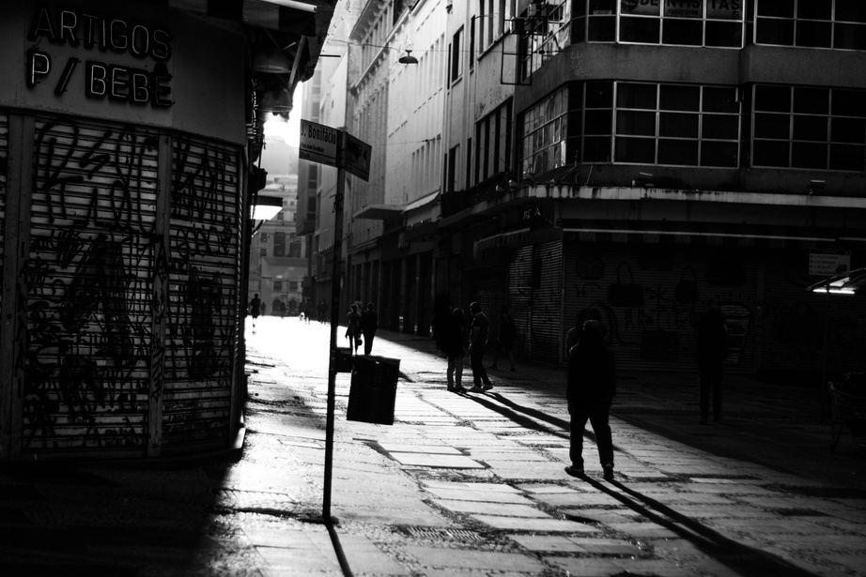
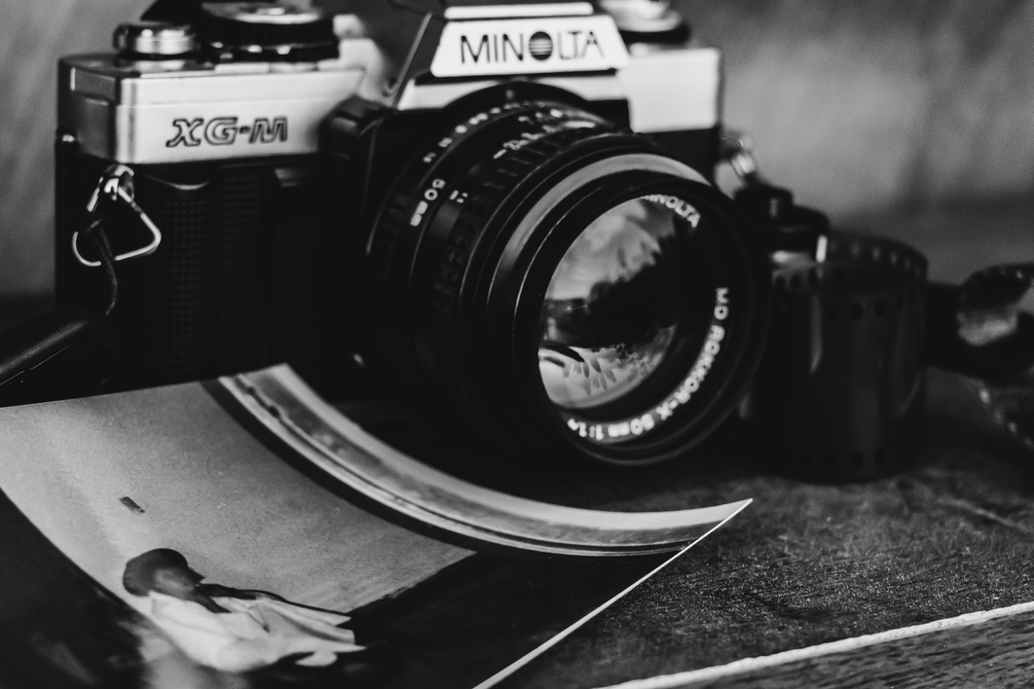
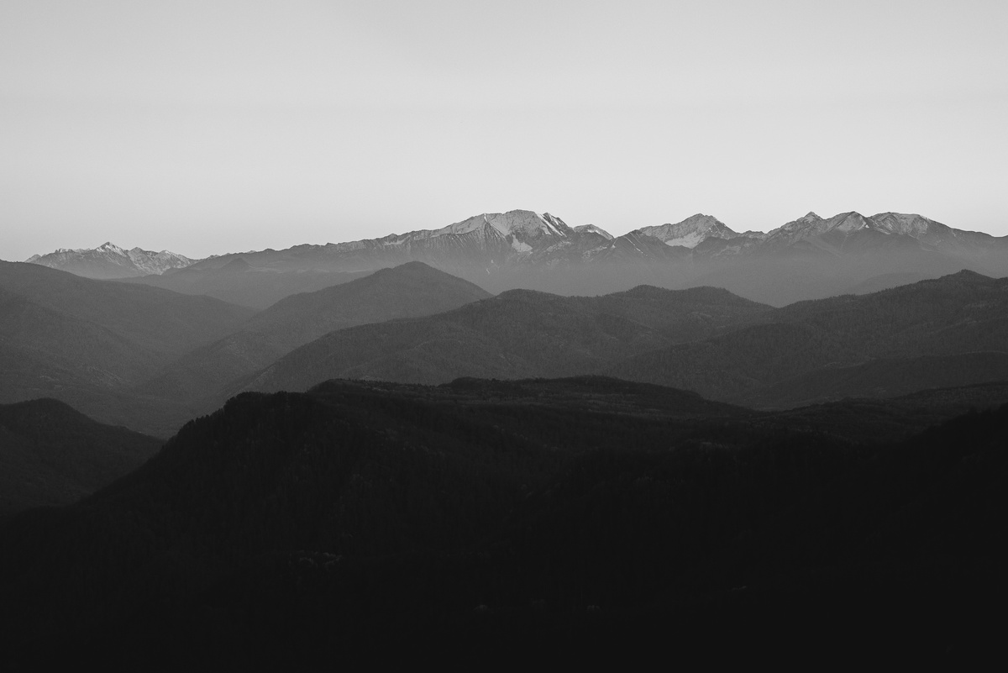
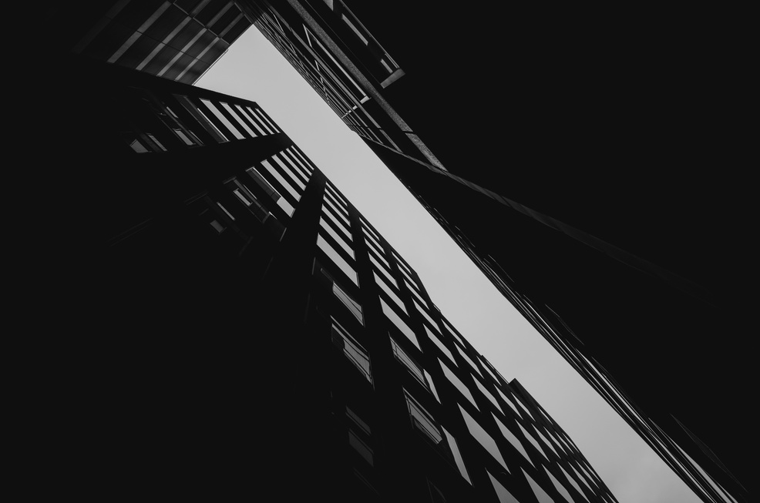
Portfolio

Slide 7
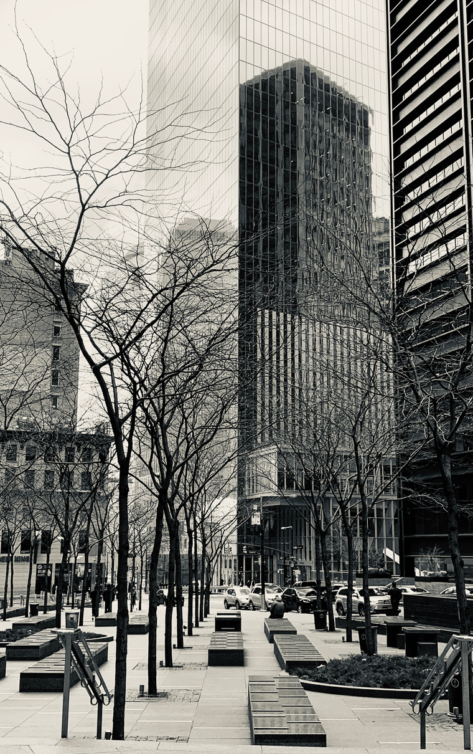

Street Photography
photography by combining the concept of a street with the technique of taking pictures from the top.

Slide 8

Street Photography
photography by combining the concept of a street with the technique of taking pictures from the top.

Slide 9
Contact Person
SEND US
+123-456-7890
Clicking on the “Send us an email” button takes you right to the contact form.
hello@reallygreatsite.com

Slide 10
THANK YOU
THAT'S MY PORTFOLIO SO FAR.

